Slide 1


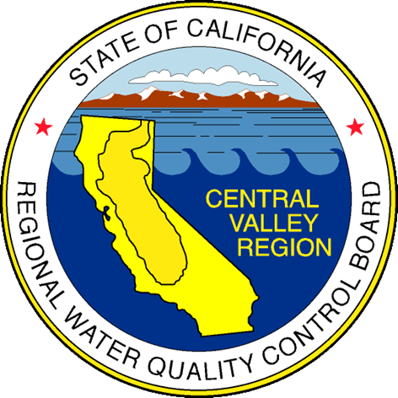
Central Valley Water Board
Regulator Update
Patrick Pulupa, Executive Officer

Slide 2
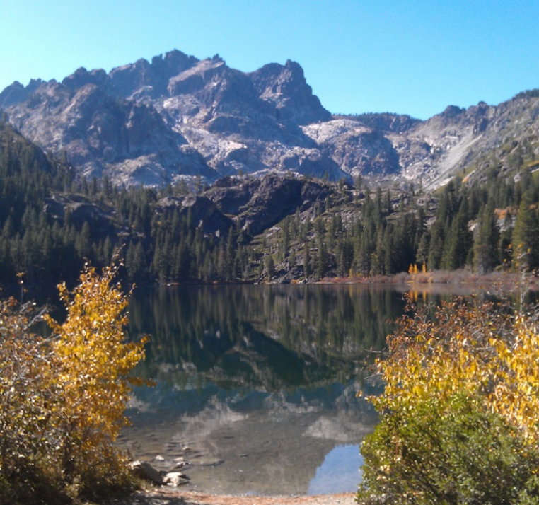
Presentation Overview
Emerging Issues: PFAS, Racial Equity, Flooding
NPDES Program Updates
Waste Discharge Requirements Program Updates
Nitrate Control Program/Salt Control Program
Planning Program
Enforcement

Slide 3
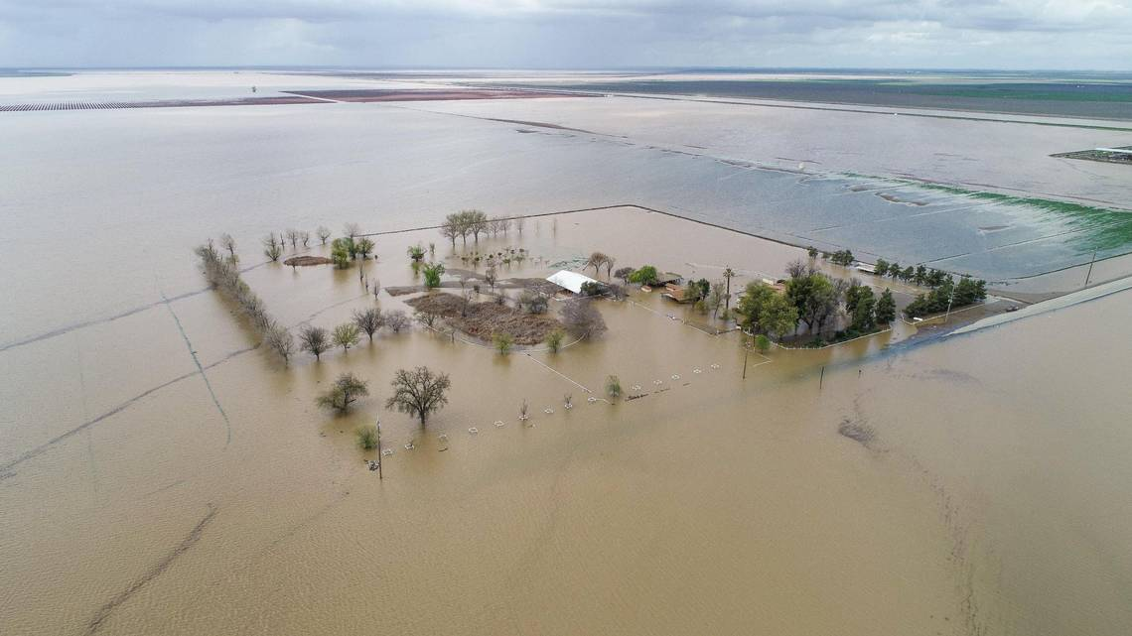
Emerging Issues
PFAS, Racial Equity, Flooding

Slide 4
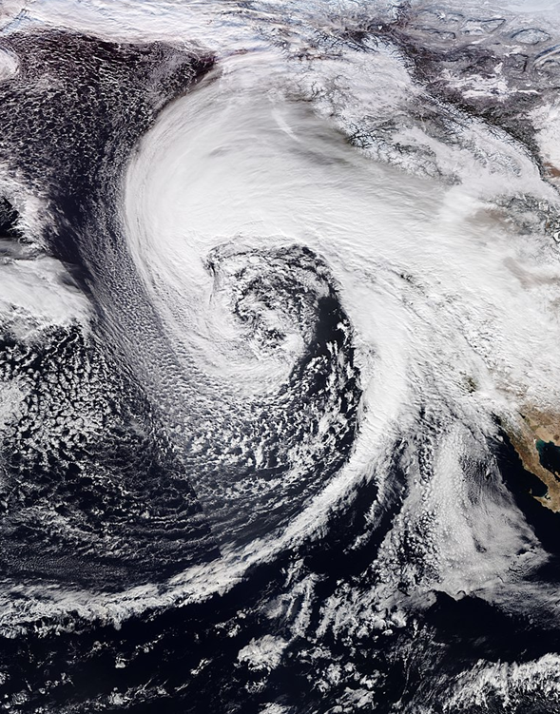
Flooding Issues
Multiple atmospheric rivers
December 31, 2022 – March 25, 2023
2022 – 2023 California Floods
Governor declared state of emergency – January 4, 2023
Climate change – Water Boards priority for California

Slide 5
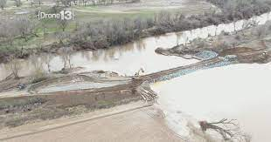
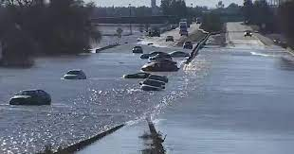
Flooding Issues
Cosumnes River levee broke – January 2023
Evacuations – Wilton
Widespread power outages (SMUD and PG&E)
Impacted multiple regulated facilities

Slide 6
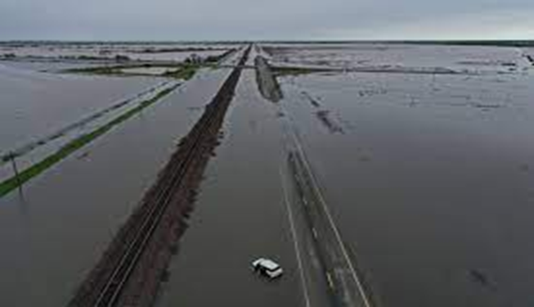
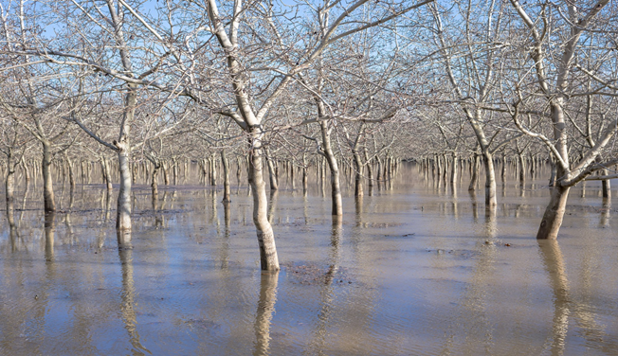
Flooding Issues
The ghost of Tulare Lake reappears and threatens farms, towns, etc.
Flooded agriculture land – Walnut orchard near the Sacramento River in Butte County

Slide 7
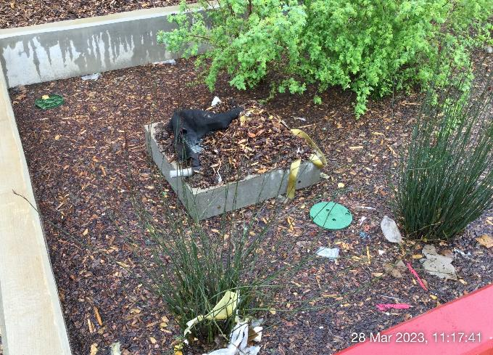
Flooding Issues
After Storms
Before Storms
Industrial facility – flooded and clogged with bark, trash, and leaves
Unpermitted 401 Certification Complaint – Fertilizer stockpiles in floodplain

Slide 8
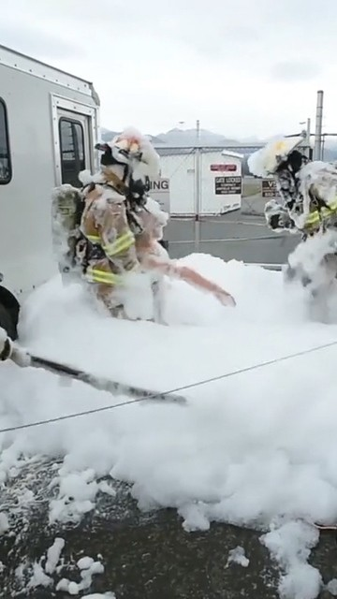
Per and Poly-fluoroalkyl Substances (PFAS)
Compound | Proposed MCLG | Proposed MCL (enforceable levels)
PFOA | Zero | 4.0 ppt
PFOS | Zero | 4.0 ppt
PFNA | Hazard Index of 1.0 (unitless) | Hazard Index of 1.0 (unitless)
PFHxS
PFBS
HFPO-DA (GenX)

Slide 9
PFAS Investigations
Facility Type | Number of Facilities
 | Named in Order | Compliant with Order ª
Airport | 6 | 6
Landfill | 59 | 58
POTW | 101 | 99
Chrome Plating Facility | 23 | 18
Bulk Fuel Terminal | 35 | 34
ª Responded with a questionnaire, work plan, and/or final report.

Slide 10
Regional Racial Equity Effort
Began in 2019 with Racial Equity Orientation trainings
Regional Board staff assigned to work with the State Water Board Team on Statewide effort in 2020
After adoption of State Racial Equity Resolution, Regional Racial Equity Team developed Regional Racial Equity Resolution
Resolution endorses State Resolution and accepts responsibility for confronting structural and institutional racism, advancing racial equity

Slide 11
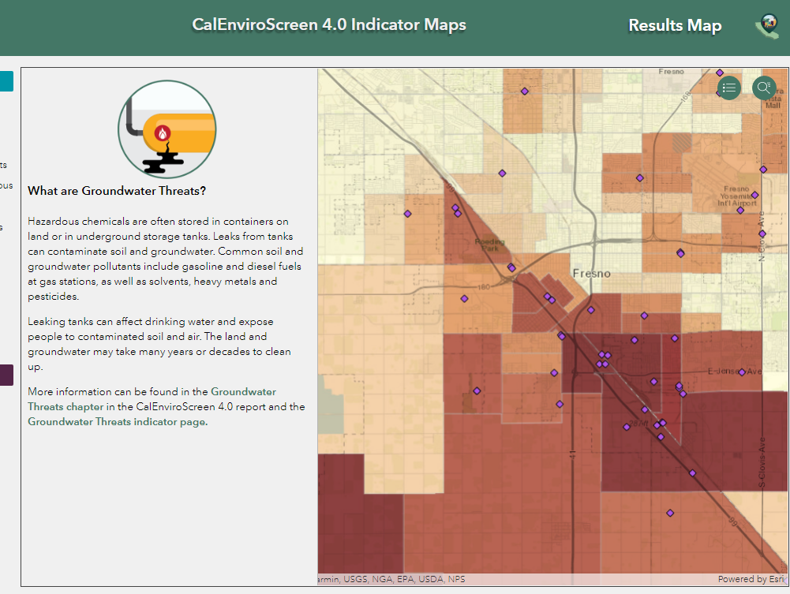
CalEnviroScreen 4.0
CalEnviroScreen 4.0 uses 21 indicators covering pollution sources and drivers of vulnerability within California’s approximately 8,000 census tracts
Measures overall cumulative burdens affecting California communities

Slide 12
AB 2108
New Outreach Requirements
Identify “issues of environmental justice” and begin “as early as possible”
Engage in equitable, culturally relevant community outreach to promote meaningful civil engagement from potentially impacted communities
New Findings
Potential environmental justice, tribal impacts, and racial equity considerations
Summary of anticipated water quality impacts in disadvantaged or tribal communities
Describe environmental justice concerns and mitigation measures

Slide 13
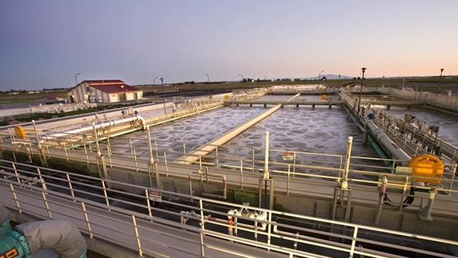
NPDES Program Update
General Order, Toxicity Provisions, Mid-Permit Reviews, Cost of Compliance Considerations

Slide 14
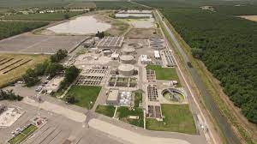
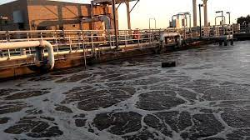
Municipal NPDES General Order
First adopted in 2017
Renewal at June 2023 Regional Board Meeting
Intended for POTWs with end-of-pipe limits
Provides a streamlined permitting process
19 Facilities Enrolled, 2 New Enrollees this year

Slide 15
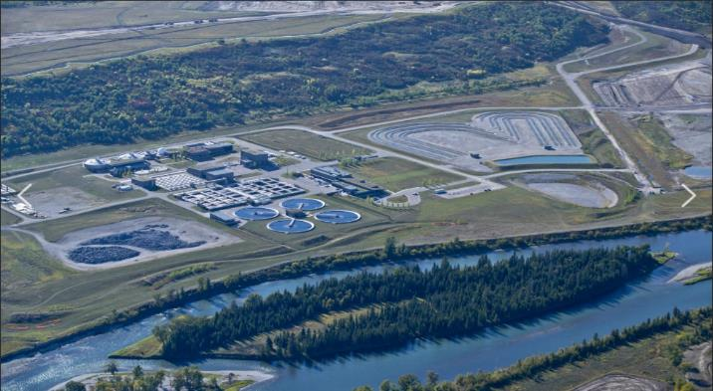
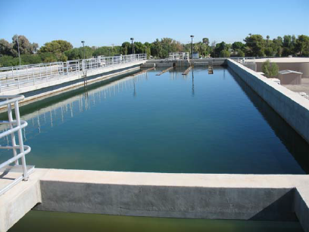
Municipal NPDES General Order
What’s new?
  Implement Statewide Toxicity Provisions
  CV-SALTS and Pyrethroid Control Program updates
  Updated requirements based on new criteria for ammonia, mercury, and aluminum
  Addition of requirements for dischargers that produce recycled water
  Site-specific requirements

Slide 16
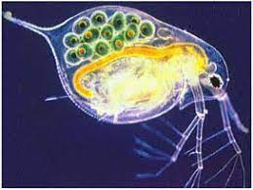

Statewide Toxicity Provisions
Statewide Toxicity Provisions
  Adopted by State Board - December 2020
  Approved by US EPA - May 1, 2023
Regional Board to implement new Provisions during permit renewals
Changes include:
  New RPA procedures
  Numeric limits required if reasonable potential
  Increased monitoring for most dischargers
  Use of Test of Significant Toxicity (TST) Statistical Approach

Slide 17

Mid-Permit Reviews
Benefits:
Conduct Preliminary RPA
Review Technical Reports
Issue ROWD reminder letter
Allows time to evaluate data issues
Challenges:
Staff Resource and Time Intensive
Competes with Permit Renewals, Amendments, TSOs, etc.

Slide 18

Cost of Compliance Considerations
Mid-permit Reviews
  Ensuring permit requirements are based on the best data
  Monitoring
  Establishing monitoring requirements that are appropriate for the type of discharge and receiving waters
General Permits
  Streamlining and reducing costs for the permitting process

Slide 19
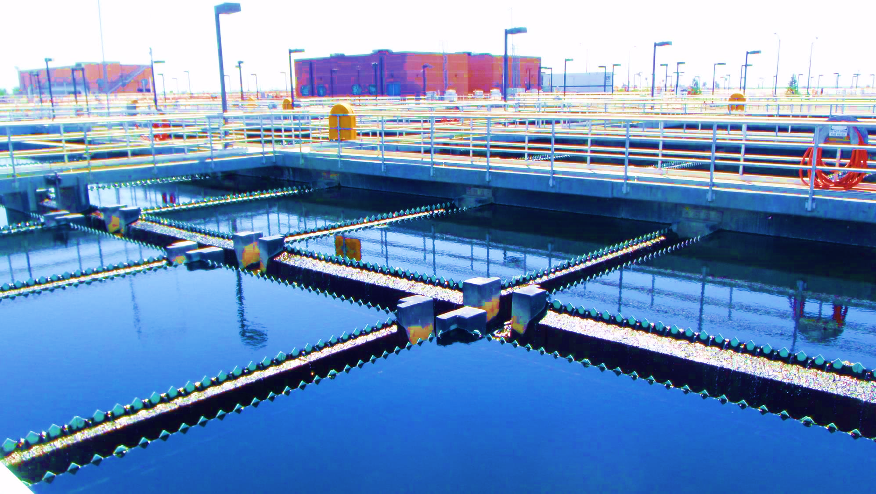
Groundwater Protection
Waste Discharge Requirements Program Updates

Slide 20
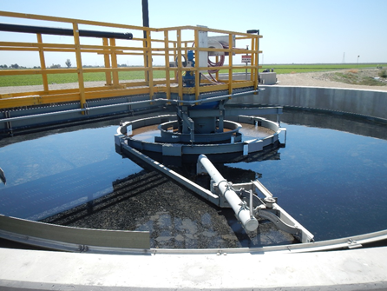
Waste Discharge Requirements Program
Implementing Outreach under AB2108
Transition the Nitrate Control Program to WDR Program Staff
Mid-Sized Domestic WWTF General Order for Facilities that Discharge to Land

Slide 21
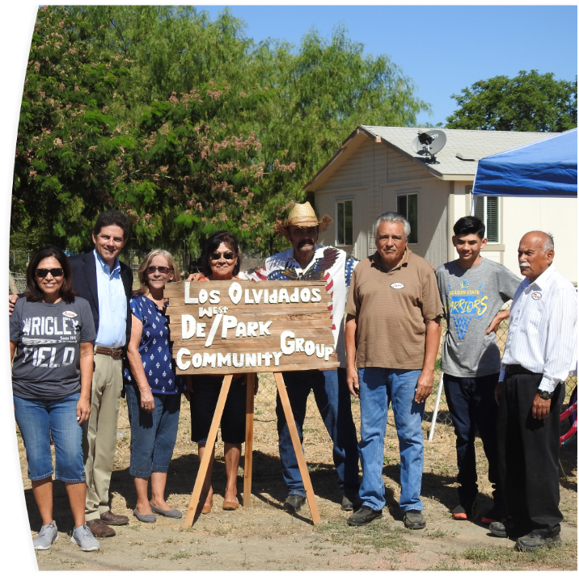
Implementing Outreach Under AB 2108
Expand Outreach to Disadvantaged Communities
General Orders
  Findings on Potential Environmental Justice, Tribal Impact, and Racial Equity Considerations
Individual WDRs
  Similar Findings as GO for WDRs with a Time Schedule to Achieve Compliance with WQOs

Slide 22
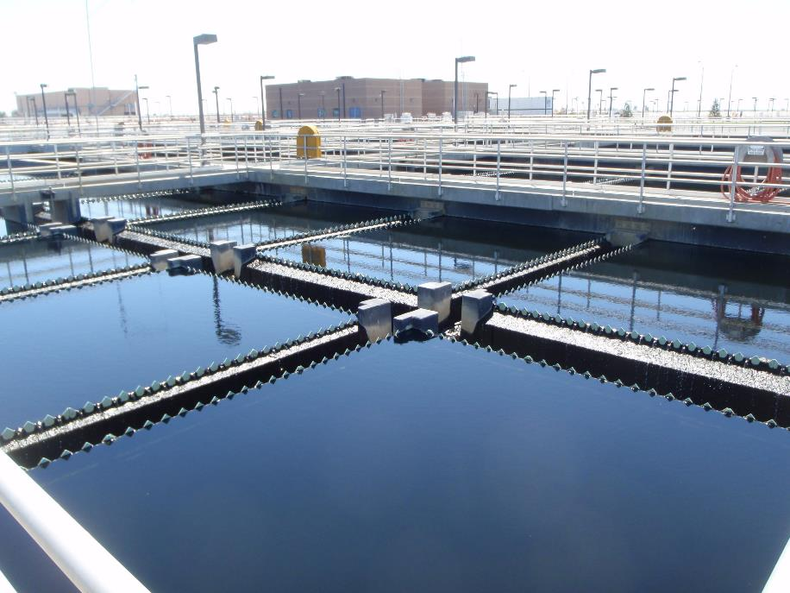
Transition of Nitrate Control Program to WDR Program Staff
Development of training modules for implementing NCP in permits
Transition Plan to WDR Permitting Units
Permit Revisions/Development of Permits for Management Zones

Slide 23
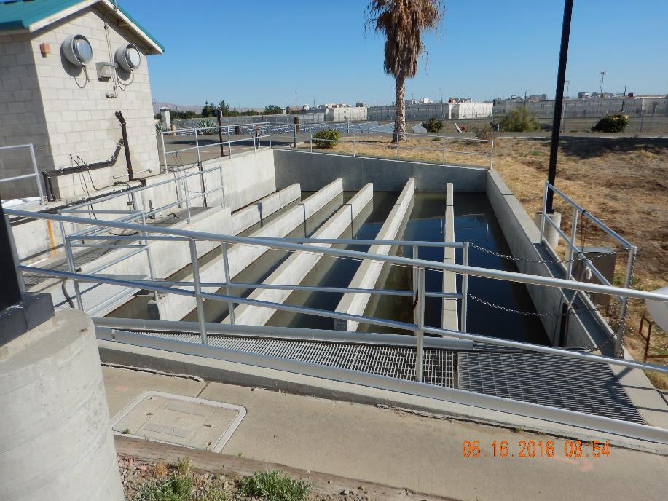
Mid-Sized WWTF General Order Development Update
Staff Transition
Incorporate Requirements of Nitrate Control Program and Salt Control Program
Outreach to Disadvantaged Communities under AB2108
Anticipated to be Adopted Next Fiscal Year

Slide 24

Enforcement
New Developments, Compliance Concerns, Sanitary Sewer Systems General Order, Priorities

Slide 25
New Developments
Challenging winter storms
  Continue to perform routine compliance and enforcement duties
  Evaluating discharger preparedness
  Accurate water balances/capacity calculations
  Winterization plans effective (e.g. empty reservoirs prior to rain, best management plans, stormwater controls)
Spill Emergency Response Plans
  Ensure up to date
  Trained operators

Slide 26
Compliance Concerns - Flooding
Flood waters still standing & snowmelt
Agricultural fields, inundated regulated facilities
Need for dewatering, saturated land application areas
Prioritizing facilities needing assistance with compliance
Requesting updated Water Balance evaluations for inundated facilities
Board encourages dischargers to reach out to compliance for assistance
Supervisor, Compliance & Enforcement Program – Kari Holmes
Kari.Holmes@waterboards.ca.gov

Slide 27
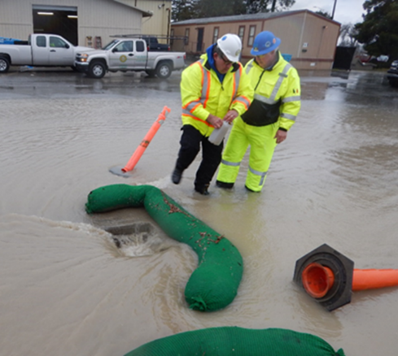
General Order for Sanitary Sewer Systems
General Order for Sanitary Sewer Systems
  Adopted December 6, 2022
  Effective June 5, 2023
Via California Integrated Water Quality System (CIWQS):
  Continuation of Existing Regulatory Coverage
  Update & Certify Legally Responsible Official
  Uploading an Existing Sewer System Management Plan
https://www.waterboards.ca.gov/water_issues/programs/sso/

Slide 28
General Order for Sanitary Sewer Systems
Regulates private systems of any size and public systems less than one mile in length
Prohibits of discharge of sewage from a sanitary sewer system that has the potential to discharge to waters of the State unless promptly cleaned up
Reduces frequency of the Sewer System Management Plan from 5 years to 6 years
Reduces frequency for local internal audits from once every two years to once every three years

Slide 29
General Order for Sanitary Sewer Systems
Central Valley has approximately 250 dischargers that still need to enroll via CIWQS to continue coverage under the Sanitary Sewer System General Order prior to June 5th
Reduces timeframe for water quality sampling of a surface water receiving a spill of 50,000 gallons or greater, from 48 hours to 12 hours
Reduces reporting requirements of less-than-50-gallon sewage spills, from monthly to quarterly
Requires annual submittal of system performance graphs
Adds new requirement for submittal of electronic sewer system service area boundary maps
Implements full electronic reporting through the CIWQS

Slide 30
Central Valley Enforcement Priorities
Mandatory Minimum Penalties (MMPs)
  Disadvantaged Communities – Compliance Projects (CPs)
  Enhanced Compliance Actions (ECAs) and Supplemental Environmental Projects (SEPs)
Discretionary Administrative Civil Liabilities
  Sanitary Sewer Overflows
  Storm Water (Industrial and Construction)

Slide 31
Central Valley Enforcement Priorities TK

Slide 32
Industrial Stormwater Non-Filer Initiative
Senate Bill 205 – effective January 1, 2020
Senate Bill 891 – effective June 1, 2023
Enroll under Industrial General Permit (IGP) to obtain or renew business license
IGP Non-Filer Expedited Settlement Agreement Policy
Region 5 Expedited Payment Letters (similar to ESA)
2023 EPA/Region 5 Effort to Identify IGP Non-Filers
  14 Facilities Identified – sent Notices of Non-Compliance
Notes:
Creating a focus and goal in stormwater enforcement program.
Capitalized on requirements under Senate Bill 205.
Senate Bill 205 became effective on January 1, 2020 throughout California – applicable businesses must show they have enrolled under the NPDES Stormwater Industrial General Permit (IGP) program, in order to obtain or renew its business license.
Senate Bill 891 expanded the application of these provisions to instruments or permits equivalent to business licenses and to the renewals of those equivalent instruments or permits. This will help us cover facilities in rural areas that do not issue a business license such as Yuba County.
EPA, State Board and the Regions have coordinated to build on existing work by Regional Boards to tell story of industrial stormwater non-filers.
Opportunity to pilot EPA’s new Expedited Settlement Agreement (ESA) policy for industrial stormwater non-filers.
Industrial SW Non-Filer ESA finalized for nationwide use 9/30/19.
Region 5 has already been identifying non-filers and have been issuing expedited payment letters to compel enrollment beginning in 2021.
An additional effort is underway in which EPA and Region 5 jointly inspected non-filers with a focus in the disadvantaged communities of Sacramento, Stockton, and Modesto where 14 unpermitted facilities were identified, and staff are working to bring them into compliance.

Slide 33
Central Valley Enforcement Priorities
CV-SALTS Compliance Initiative
Conduct outreach to dischargers – ongoing enrollment for new dischargers
Issue Notices of Deficiency – as needed
Issue Notices of Violation – as needed
Issue Administrative Civil Liability Complaints – as needed
Coordinate and support CV-SALTS program staff to implement the Salt and Nitrate Control Programs in NPDES permits
  Develop enforceable permit language

Slide 34
Central Valley Enforcement Priorities
Disadvantaged/Environmental Justice Communities
Enhanced engagement
  State Board – Office of Public Participation
Multiple stakeholders – Central Valley Region
  Counties, Cities, Caltrans, California Department of Fish & Wildlife, Central Valley Flood Control Board, Tribes, community residents
Form working groups
  Tackle environmental justice efforts
  Establish similar goals
  Coordination
  Leveraging resources

Slide 35

Nitrate and Salt Control
Nitrate Control Program and Salt Control Program Implementation

Slide 36
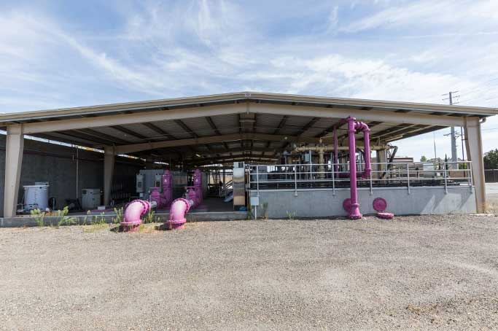
Nitrate and Salt Updates to Permits
Nitrate Compliance
Individual Approach
Management Zone Permitting Approach
Salt Compliance
Conservative Approach
Alternative (P&O Study) Approach

Slide 37
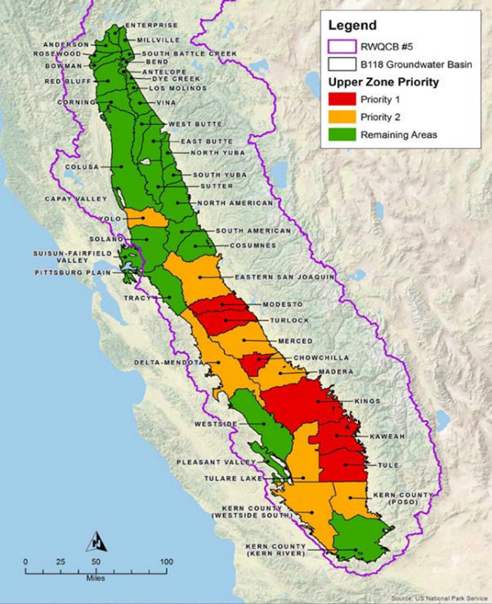
Nitrate Control Program
Priority 1 Area (Red)
Notice to Comply Letters May 2020
Priority 2 Area (Orange)
Notice to Comply Letters scheduled for December 2023
Remaining Areas (Green)
Implementation to be phased in after priority areas

Slide 38
Management Zone Deadlines
Preliminary Management Zone Proposal/Early Action Plan | 3/8/2021
Implementation of Early Action Plan | 5/7/2021
Final Management Zone Proposal | 8/29/2022
Management Zone Implementation Plan | 9/5/2023

Slide 39
Nitrate Control Program Compliance

Slide 40
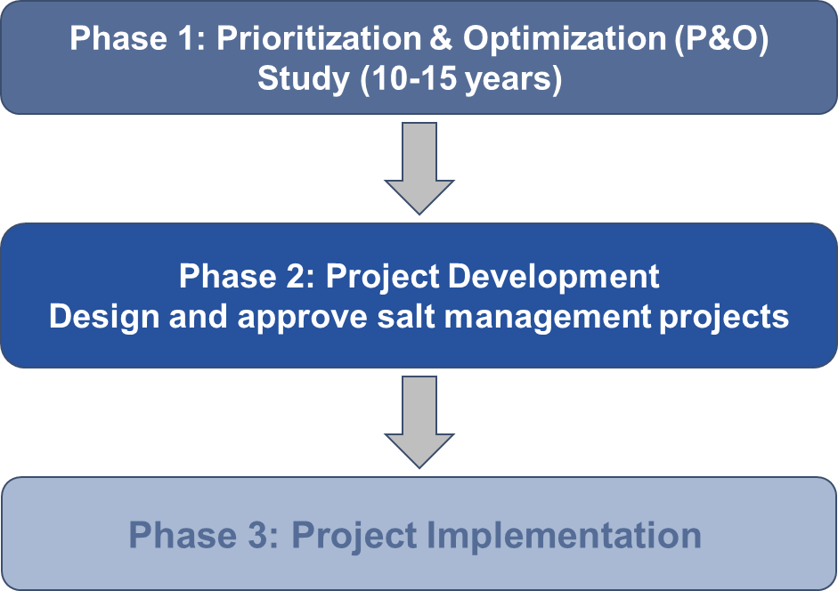
Salt Control Phase 1 : Prioritization and Optimization Study
Applies to all permitted dischargers of salt in the Central Valley Region
Notice to Comply Letters January 2021
Notice of Intent Due Date July 15, 2021

Slide 41
Prioritization and Optimization Study Status
Phase 1 of P&O Study Workplan | Approved 29 March 2021
Baseline Characterization Report Part 1 | Drafted December 2022
Analytical modeling tools selected | Accepted November 2022
Beneficial Use Literature Review | Drafted​ November 2022
P&O Study Year 1 Progress Report | Drafted March 2023
Surveillance and Monitoring Program Workplan | Approved March 2023

Slide 42
Prioritization and Optimization Study Next Steps
Perform initial, baseline model runs | Summer 2023
Complete Baseline Characterization Report Part 2 (with salt loading) | September 2023
Selection and analysis of Salt Management Regions and Salt Management Areas​ | 2023-2025
Selection and analysis of Archetype Areas | 2023-2025
Numeric target development​ | 2024-2025
Analytical Tool Development | 2024-2025

Slide 43
Salt Control Program Compliance

Slide 44

Secondary Maximum Contaminant Levels
  Clarify use of SMCL ranges
  Compliance Periods under new Policy
    Surface Water: Annual Averages
    Groundwater: Annual Average for permit compliance, long-term average for ambient assessment
Filter Sample Using 1.5-micron filter
  Analyze sample for total levels

Slide 45
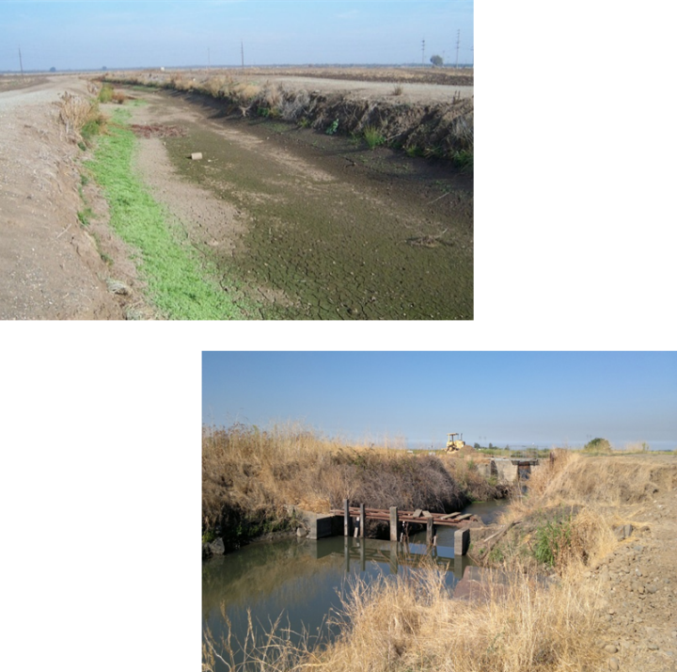
MUN Evaluation in Agriculturally
Dominated Water Bodies
2017 - Adopted by Regional Board
2018 - No approval by State Board
2019 - State Board staff review
2020 - Returned to Regional Board with recommended changes
2021 - Regional Board staff worked on revisions
2023 – On hold pending resource availability

Slide 46
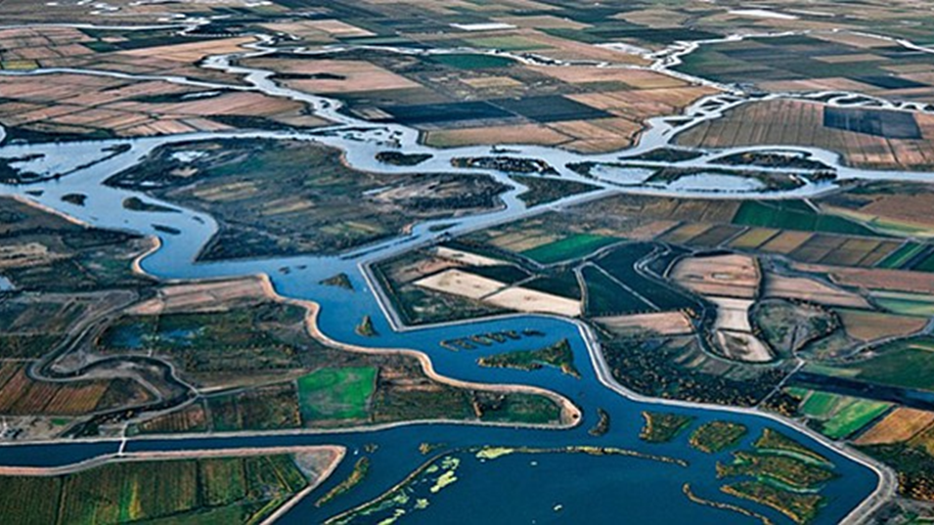
Planning
Mercury, Tribal Beneficial Uses, Biostimulatory Substances, Delta Regional Monitoring, Triennial Review, Integrated Report

Slide 47
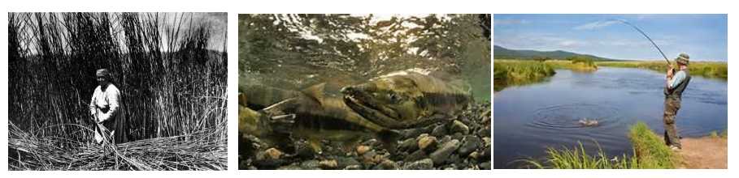
Delta Mercury Control Program Review
Phase 1 Review ongoing
  Data analysis and draft staff report
Phase 2 began October 2022
  Concurrent with Phase 1
Mercury Offset Program
  Will continue to be considered as data analysis progresses

Slide 48

Tribal Beneficial Uses
Definitions added to the Basin Plans through a Basin Plan Amendment
  Approvals still needed from Office of Administrative Law and USEPA
Designations will be through Basin Plan Amendments
  Review designation requests received
  Expect to begin formal designation project in late 2023

Slide 49
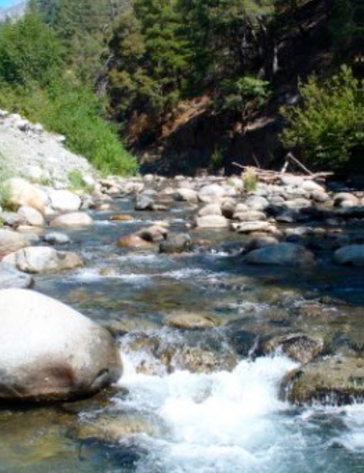
Biostimulation, Cyanotoxins, and Biological Condition Provisions
State Water Board developing Provisions
Applicable to inland surface waters
  Numeric or narrative water quality objectives
  Biological condition assessment methods
Assessment of lakes and reservoirs
  Evaluate conditions from existing data
  Understand potential impacts of Provisions in Central Valley

Slide 50
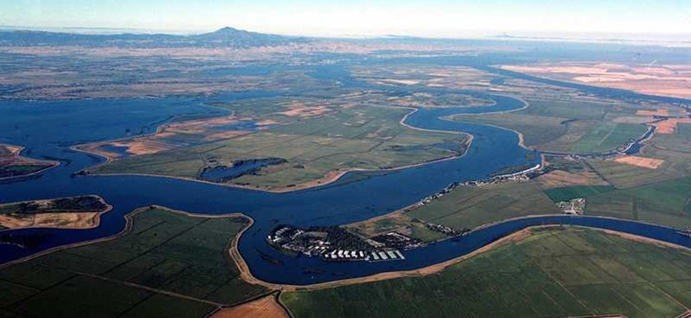
Delta Regional Monitoring Program
FY23/24 revenue is ~$1.4M
  Regional Water Board provides ~$200k in analysis funding
New governance and program structure
  Nonprofit Implementing Entity formed by regulated agencies
  Transition to new Implementing Entity completed
Water Quality Focus Areas:
  Mercury (water and fish)
  Pesticides and toxicity
  Contaminants of Emerging Concern
  Nutrients and harmful algal blooms

Slide 51
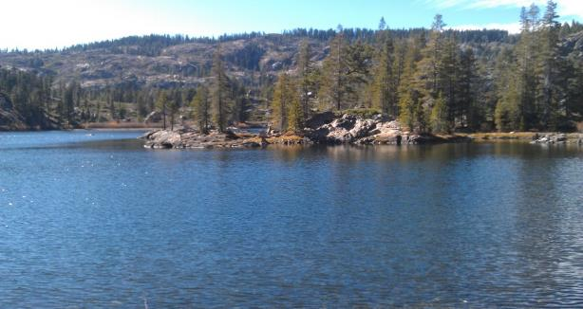
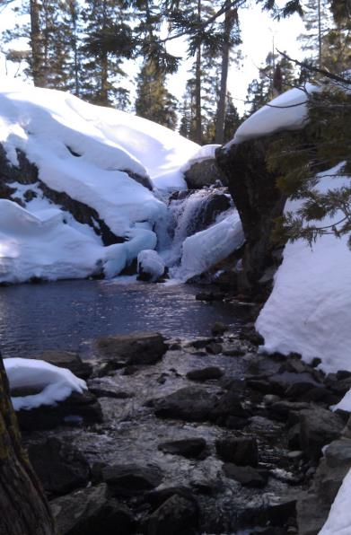
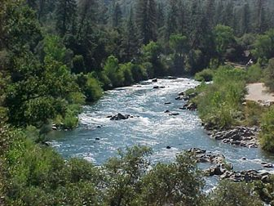
2024 Triennial Review
Prioritize Basin Planning Projects (2025-2027)
Comment solicitation to be issued fall 2023
Draft 2024 Triennial Review Workplan expected spring 2024
December 2024: Central Valley Water Board Consideration

Slide 52
2024/2026 Integrated Report
2024 Integrated Report – Sacramento River Watershed
  Public Review and Comment Period Complete
  State Board Consideration of Approval – Winter 2023
  Proposed: 123 New Listings, 57 New De-listings
2026 Integrated Report – San Joaquin River Watershed
  Data processing in progress
  Public Review and Comment Period – Spring 2025
  State Board Consideration of Approval – Winter 2025

Slide 53
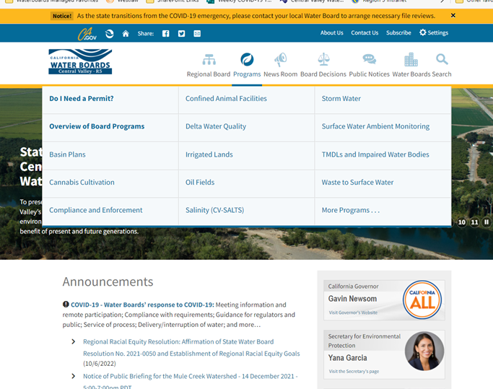
Program Overviews, Goals, Resources, Accomplishments & Priorities
https://www.waterboards.ca.gov/centralvalley/about_us/program_overview/

Slide 54
Patrick Pulupa, Executive Officer
Patrick.Pulupa@waterboards.ca.gov

