Slide 1

POTW Requirements Beyond Effluent: Air, Fleet/Fuel, Land
Sarah A. Deslauriers, PE, ENV SP
Carollo / California Association of Sanitation Agencies (CASA)
CVCWA / MAY 11, 2023

Slide 2
Air: CARB Air Toxics Reporting Requirements
01

Slide 3
CARB’s updated Criteria Air Pollutant & Toxic Air Contaminant Reporting (CTR) effective Jan 1, 2022
AB 617 gives CARB authority to “harmonize” air monitoring, reporting, & emission reductions from stationary sources across the state
AB 2588 Hot Spots compound list is now >1,700 compounds (from >500), including PFAS:
  Many with unknown toxicity levels
  Many with unknown emission factors
  Many are not relevant to WWTPs
CASA negotiated phased compliance (summary), allowing WWTPs to:
  Report business as usual through 2028 (begin reporting in 2029)
  Perform a “two-step process” for determining shortlist of compounds
    Scan air space of unit processes to determine detectable compounds
    Determine the sampling and analysis methods to quantify emissions
    (Mimic 1990 Pooled Emissions Estimation Program, PEEP)

Slide 4
What does this mean for you?
Who does this apply to?
  ≥5 MGD, uncovered primaries
  ≥10 MGD, covered primaries
What is required?
  Participation in a two-step process (whether as a statewide group or individually)
How can we work together?
  Participate in CASA’s Air Toxics Subgroup (email list and/or monthly meetings)
  Next meeting: June 14th, 1-2 pm

Slide 5
Fleet: CARB Advanced Clean Fleet (ACF) Regulations
02

Slide 6
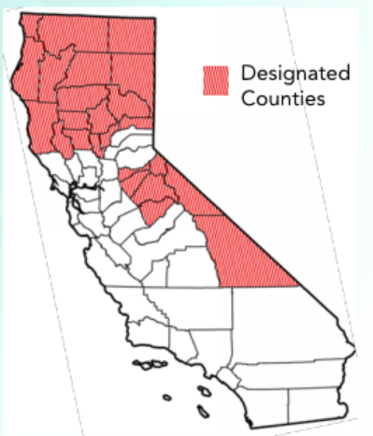
ACF Regulations adopted April 28th require transition of medium- to heavy-duty vehicles to zero-emission!
  Public Fleets Regulation
  Applies to State and local government fleets (city, county, special district, State agency)
  If NOT considered a low population county, having >10 vehicles in fleet:
  January 1, 2024, 50% of vehicle purchases in each calendar year must be ZEVs
  January 1, 2027, 100% of vehicle purchases in each calendar year must be ZEVs
  If considered low population county, ≤10 vehicles in fleet:
  January 1, 2027, 100% of vehicle purchases in each calendar year must be ZEVs.
  Exemptions/Extensions may apply – CASA is looking to streamline process!

Slide 7
ACF Regulations adopted April 28th require transition of medium- to heavy-duty vehicles to zero-emission!
  High Priority & Federal Fleets Requirements
  If you are large (>50 vehicle) or have trucks that support diversion of organic waste in effort to implement SB 1383 mandates, you can opt into this regulation
    Allows more time to transition medium- and heavy-duty fleet vehicles
    Does NOT provide for the anticipated expansion in trucks fueled by compressed biomethane (CNG) in support of SB 1383 (only allows trucks in fleet as of January 1, 2024)
Percentage of vehicles that must be ZEVs → | 10% | 25% | 50% | 75% | 100%
Milestone Group 1: Box trucks, vans, buses w/ two axles, yard tractors, light-duty package delivery vehicles | 2025 | 2028 | 2031 | 2033 | 2035 & beyond
Milestone Group 2: Work trucks, day cab tractors, buses with three axles | 2027 | 2030 | 2033 | 2036 | 2039 & beyond
Milestone Group 3: Sleeper cab tractors and specialty vehicles | 2030 | 2033 | 2036 | 2039 | 2042 & beyond
CASA is summarizing the regulation applicability and exemptions/extensions!

Slide 8
Wastewater sector biogas (renewable biomethane) needs a long-term home!
Increasing limitations from local air districts on onsite use for renewable energy production – what about resilience?
Existing limitations on pipeline injection – geographic location, expense, CalOSHA limitations
Now the ACF limits use of biomethane as a transportation fuel; however,…
On April 28th before approving the ACF Regulations, CARB Chair and Board stated “…multiple reliable uses for non-fossil biomethane will be needed,...and directs staff to report to the Board by the end of 2025 on progress for alternative uses of biomethane including identifying any appropriate regulatory actions as needed.”

Slide 9
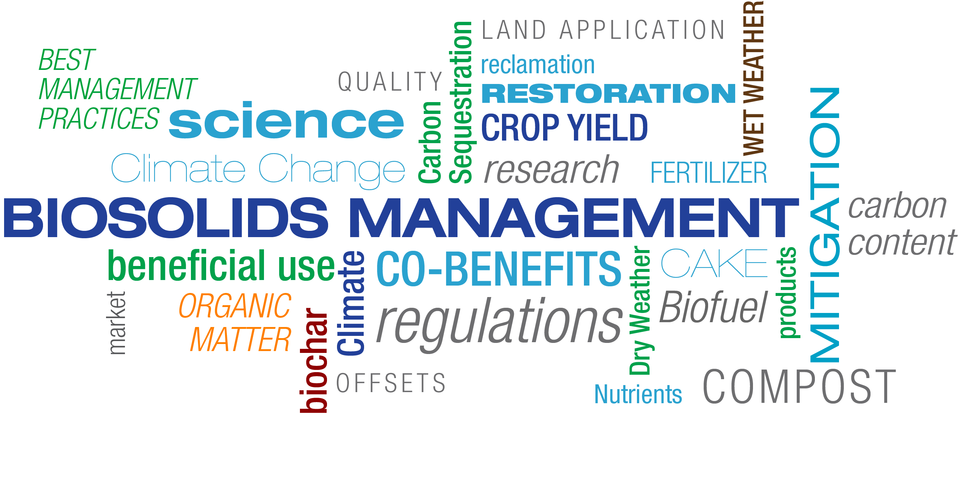
Land: Carbon Sequestration & Healthy Soils
03
Notes:
Address PFAS

Slide 10
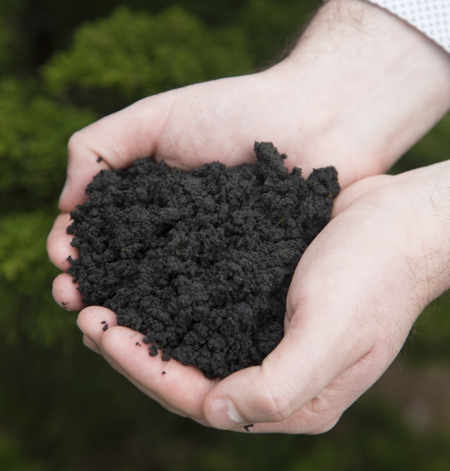

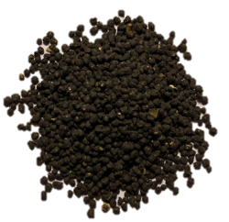
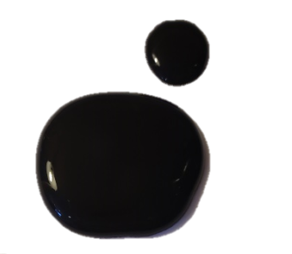
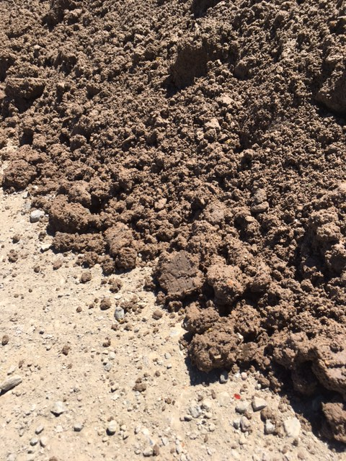
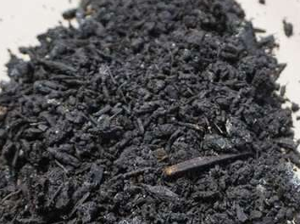
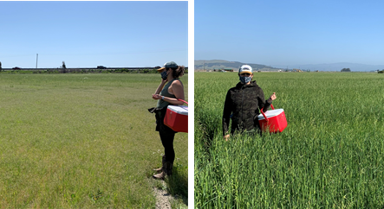
Benefits of biosolids
Offset inorganic fertilizer use
Increase soil carbon content/stability
Increase water holding capacity
Increase nutrient use efficiency
Increase crop yield
Sequester carbon in the soil
...the 2022 Scoping Plan Update, 2022 and 2023 legislation, and SB 1383 regulations, target beneficial use of recycled organics, in turn, a shift in biosolids management away from ADC or disposal at landfills.
Without Biosolids
With Biosolids

Slide 11
As PFAS and other concerns emerge, we pursue and participate in research to answer questions
Benefits of biosolids
  UC-Merced and Virginia Tech – carbon sequestration
  Biosolids Emissions Assessment Model (BEAM) – GHG emissions comparison
Safety of biosolids (identify when pre-treatment/source control is needed)
  EPA Evaluation of Pollutants in Biosolids – 4 projects awarded at $1.5M each
  UC-Davis on potential plant uptake of PFAS
  National Collaborative PFAS Study led by University of AZ
  USDA NRCS Research on PFAS
  SWRCB PFAS Investigative Order
  SWRCB Microplastics Strategy

Slide 12
Using research findings to hold regulatory discussions to identify gaps (if any) and work to close those gaps

Slide 13
In addition to research…
Bay Area Biosolids Coalition is performing a RFI from solution providers on the latest developments in emerging technologies
CASA to summarize funding sources for biosolids related projects (including beneficial use of biosolids)
Updating Matrix

Slide 14
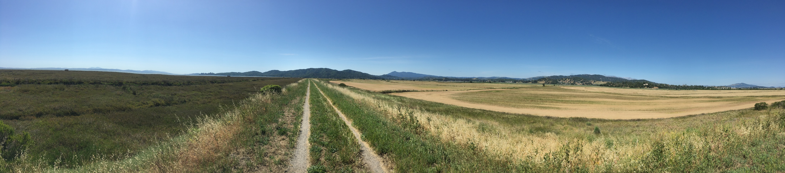
Thank You!
Sarah A. Deslauriers, PE, ENV SP sdeslauriers@Carollo.com, 925-932-1710
Carollo Resilience & Sustainability Practice Director
CASA Climate Change Program Manager
Questions?
Source: Mary Cousins, 2022

