Slide 1
State Water Board Priorities
Karen Mogus
Deputy Director for Water Quality
May 2023

Slide 2
Overview
Ocean acidification, harmful algal blooms and nutrients
Water Supply Strategy
PFAS
Funding

Slide 3
Ocean Acidification, Harmful Algal Blooms & Nutrients
West Coast Ocean Acidification and Hypoxia Science Panel
  926_WestCoastOAHSciencePanel.pdf (sccwrp.org)
  Global carbon emissions are the dominant cause of ocean acidification
  Local conditions can be improved through reduction of human sources of nutrients
  Recommended development of robust predictive models of ocean acidification and hypoxia

Slide 4
Preliminary Model Findings
Human sources of nutrients do cause measurable changes in ocean chemistry that…
Reduce the volume of ocean habitat by up to 30% over 25% of the Southern California Bight during 3 months of the year

Slide 5
HABs in California
 | 370 | 2017 | 2018 | 2019 | 2020 | 2021 | 2022
Reports | 91 | 181 | 190 | 241 | 370 | 603 | 684
Oregon to Mexico
High elevation to the coast
Urban and rural areas
Drinking water reservoirs and natural lakes
Rivers
Cyanotoxins in estuaries
Occur every month, peak in summer
Notes:
In California, we have HABs all over the state. You can see that the number of voluntary reports submitted to our office has increased each year since the program began in 2016. On the map, I’ve highlighted some notable bloom locations that characterize the diversity of HABs across the state. They span both North to South across the state from Oregon to Mexico. Klamath River to urban parks in San Diebo
They also cross a large elevation gradient from blooms near the coast, such as Pinto Lake which sends cyanotoxins into Monterrey Bay to blooms >6000 feet in the Sierra Nevada, such as Lake Crowley, one of the reservoirs in Los Angeles water system.
We find them in both urban and rural areas, human-made reservoirs and natural lakes,
In the North Coast, cyanobacteria in rivers are a common occurrence; rivers,
In Southern California, cyanotoxins have been found in almost all the coastal estuaries, and there has been extensive research into cyanobacteria at the land-sea-interface in California. Much of that work led by Meredith Howard, prior to joining RB5 in 2018.
They also occur in every month of the year, though they peak in abundance during the summer.

Slide 6
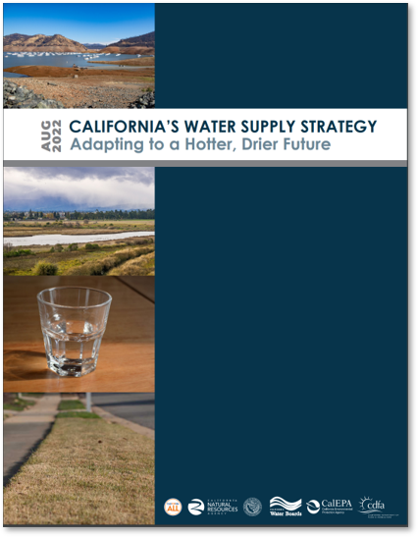
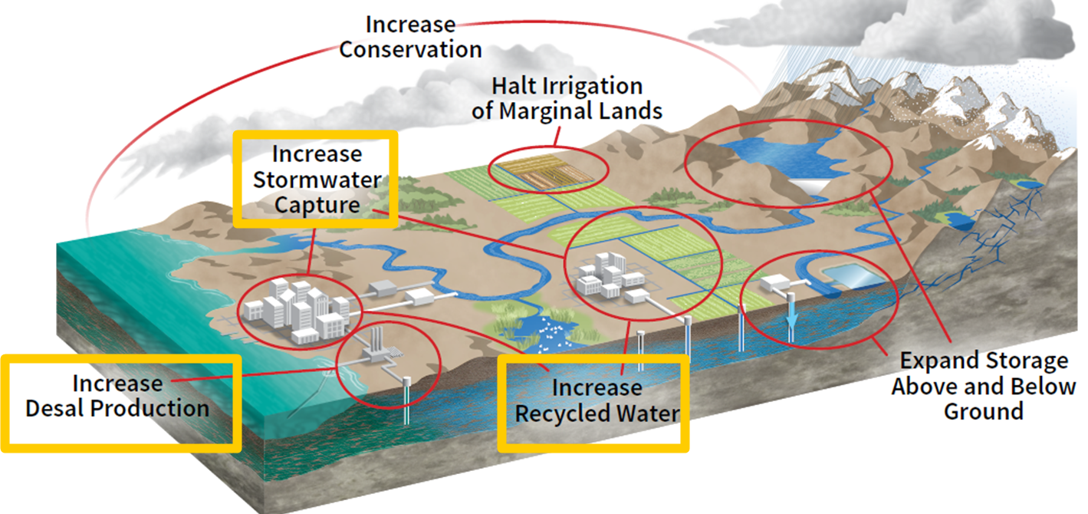
California’s Water
Supply Strategy
Notes:
Better forecasting and statewide modeling that takes into account the realities of climate change -- decreasing snowpack, less rainfall, and greater evaporative water loss due to hotter, drier conditions -- has allowed the Administration to identify a deficit in projected statewide water supplies by 2040.
This strategy is in response to this deficit, to ramp up actions the state will take, due to the urgency of the need.
This strategy represents an expedited timeline for actions earlier identified in the Administration’s 2020 Water Resilience Portfolio which outlined 142 separate actions to strengthen state support for local efforts to withstand drought and flood, provide safe and reliable water supplies to all communities, and protect natural systems.

Slide 7
Water Supply Strategy Goals
Develop New Water Supplies | 2030 | 2040
Increase Recycled Water | 800,000 AF | 1,800,000 AF
Increase Desal Production | 28,000 AF | 84,000 AF
Increase Stormwater Capture | 250,000 AF | 500,000 AF

Slide 8
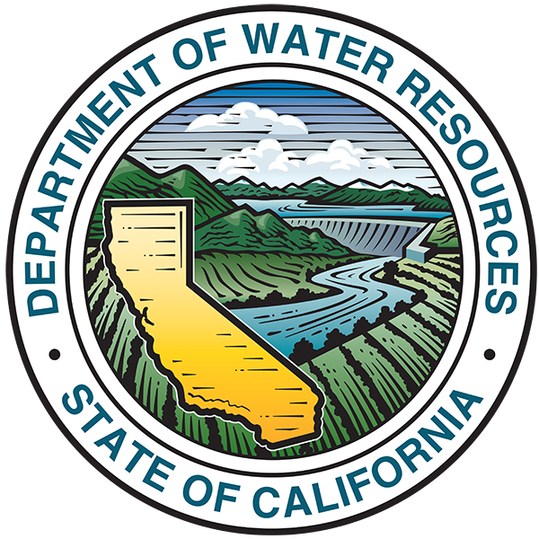


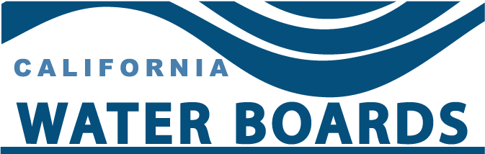

Water Board Actions – Recycled Water
2022-2024
Implementation Actions
Department of
Water Resources
SWRCB - DWQ
Direct Potable Reuse Regulations
December
2023
DDW
SWRCB - DFA
RWQCBs
Convene strike team to identify and resolve permitting and funding barriers.
Identification of Recycled Water Projects,
Public Dashboard
DWQ
January
2024
DFA
Stakeholders -
(WateReuse,
CASA, Keepers)
SWRCB
- DDW
OIMA
Notes:
So now we’re going to give a brief overview of some of the Water Boards actions outlined in the Water Supply Strategy
Recycled water is one of the supplies with the greatest potential for development, and we are already making significant strides to advance its use statewide.
Division of Drinking Water is carrying out a series of legislative mandates regarding Direct Potable Reuse. An expert panel has reviewed the draft regulations and provided its findings to DDW. Staff is on track to present the draft regulations for adoption consideration by the State Water Board by December 31, 2023​.
Division of Water Quality staff, in coordination with Division of Financial Assistance, DDW, and the Regional Boards, convened a strike team in January 2022 to identify and resolve permitting and funding barriers to recycled water development. That group has compiled a list of projects either planned or underway and the Regional Boards are in the process of reviewing that list. The strike team will convene again in May to begin prioritizing the list of projects and initiating targeted outreach to identify and, if possible, remove barriers to project delivery to meet the strategy goals.
DWQ staff will also take the lead, in coordination with DFA and the Office of Information Management and Analysis to develop a public dashboard for current and proposed recycled water projects.
Division of Financial Assistance has compiled a list of current and proposed projects, which will be a starting point for this analysis.​
Staff will also coordinate with WateReuse CA, CASA, and other stakeholders to identify planned recycled water projects and will consider adding a module to the Volumetric Annual Report to allow facilities to report planned increases in recycled water volumes as applicable. ​

Slide 9
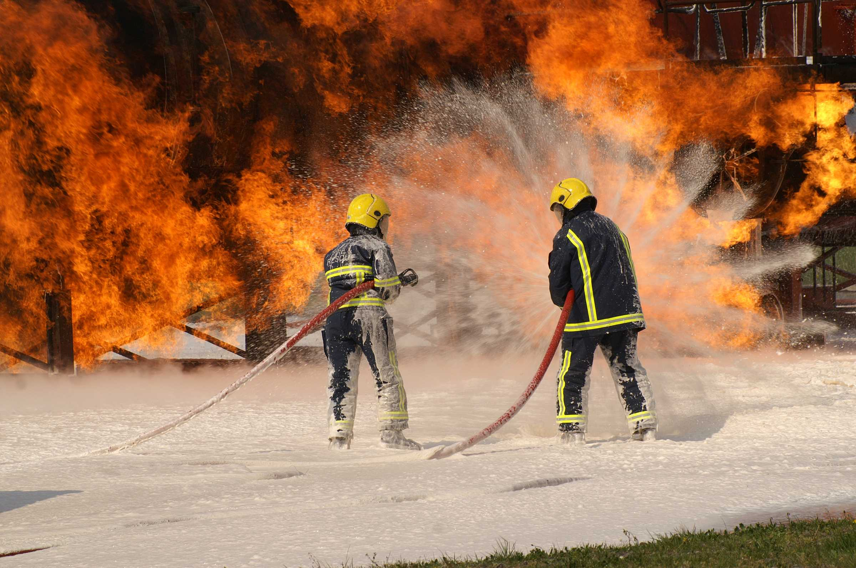
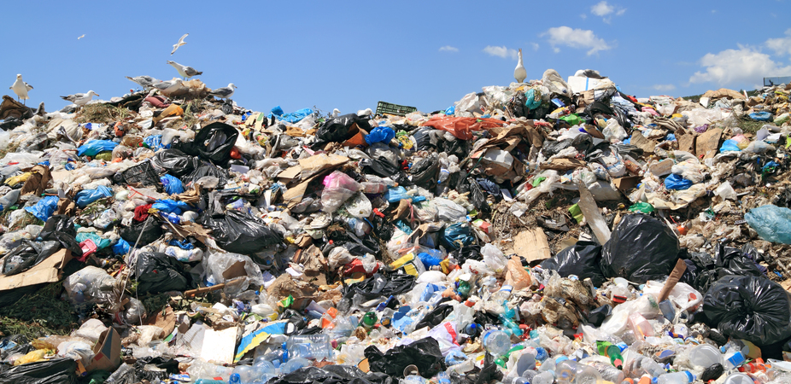
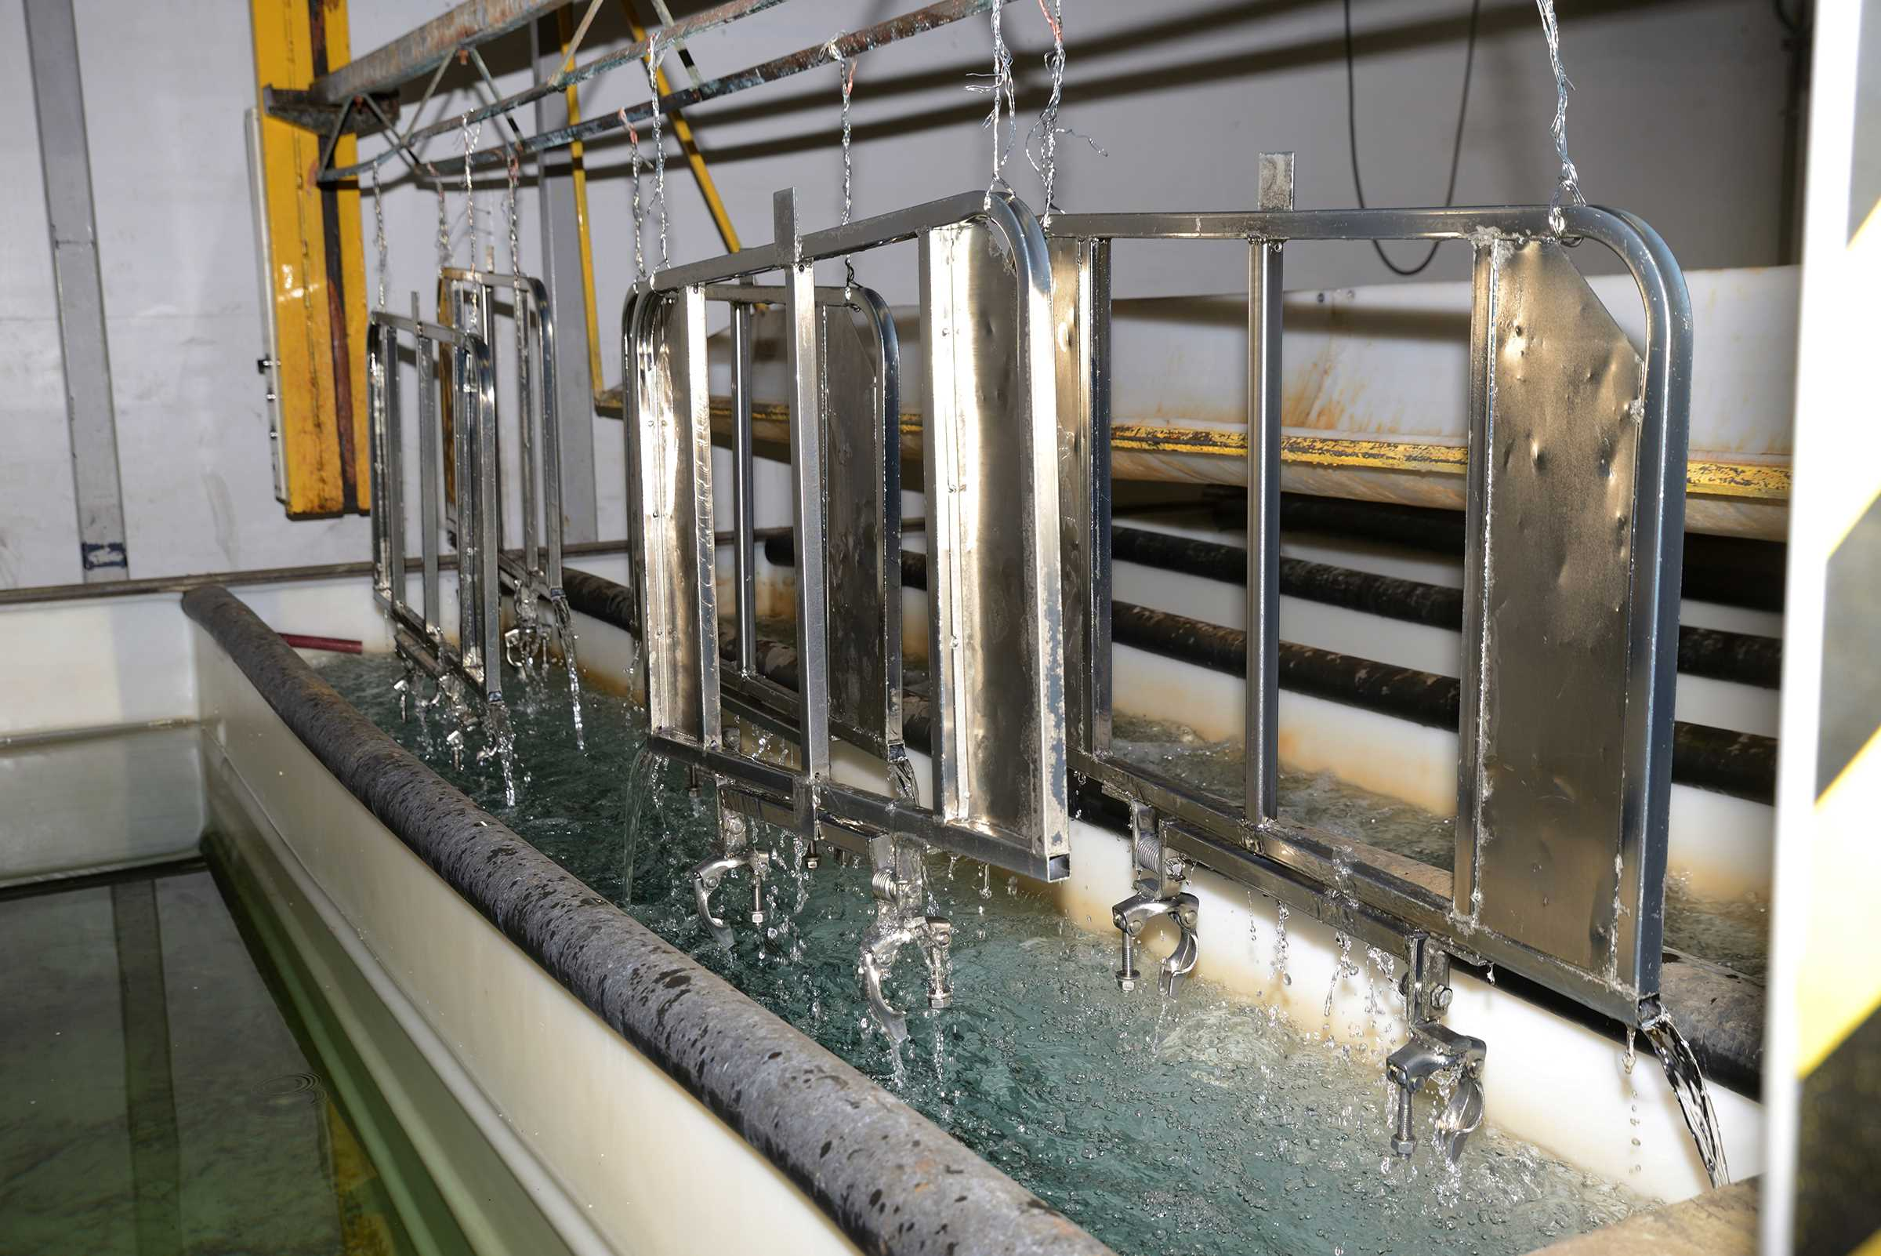
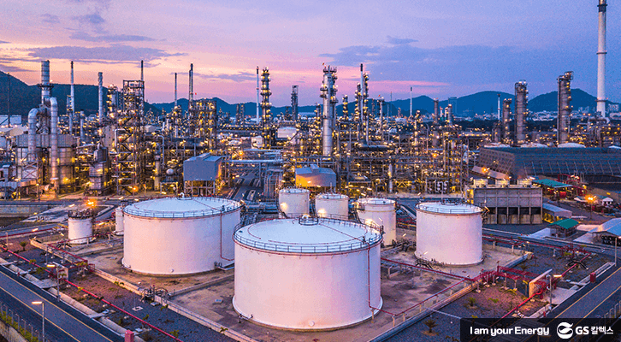
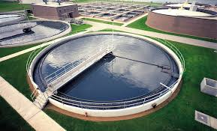

Water Board Statewide PFAS Investigative Orders
  Airports
  (2019)
  Municipal Solid Waste Landfills
  (2019)
  Chrome Plating Facilities
  (2019)
  Bulk Fuel Terminals/ Refineries (2021)
  Publicly Owned Treatment Works (2020)
  Public Water Systems (2019, 2020, 2021, 2022)
March 2023
9

Slide 10
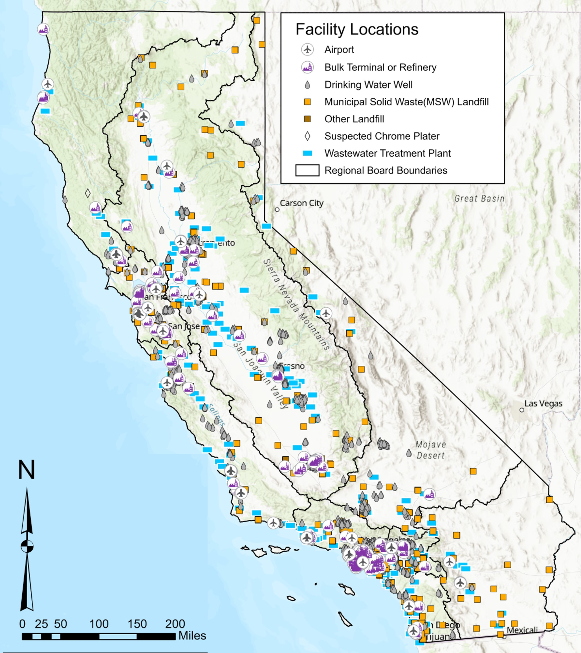
Occurrence of PFAS
is Being Gathered Statewide
March 2023
10

Slide 11
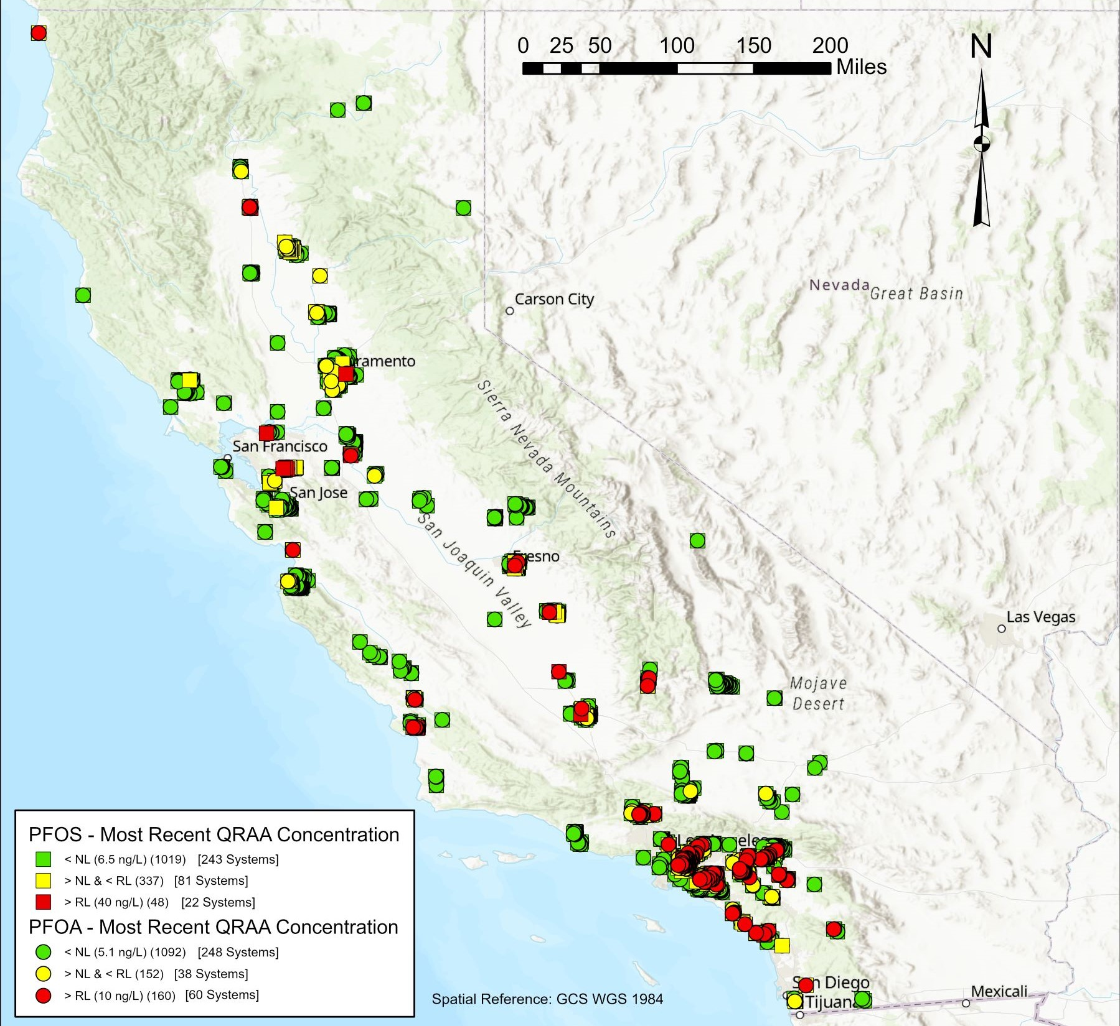
2021
PFOA/PFOS - Drinking Water Supply Wells
Data downloaded in February 2022 – raw water results
NL = Notification Level; QRAA = Quarterly Running Annual Average
RL = Response Level
PFOA and PFOS analyzed using EPA Method 537.1
PFOA: = NL = 5.1 ng/L, RL = 10 ng/L │PFOS: NL = 6.5 ng/L, RL = 40 ng/L
March 2023
11

Slide 12
AB-178 (Budget Act of 2022)
Develop and validate a broad-spectrum test method for the class of PFAS
Monitor all community public water systems in the state at least once, with state funding directed to accomplish PFAS testing of community public water systems serving disadvantaged and severally disadvantaged communities*
Develop a treatment-based regulation for the entire class of PFAS
*Approximately 4,000 wells in California
March 2023
12

Slide 13
Funding
Clean Water State Revolving Fund Intended Use Plan (IUP)
Grants/Principal Forgiveness
Fundable List
Schedule
  May 19, 2023 - Draft IUP Posted for 30-day Public Comment Period
  June 20, 2023 – Public Outreach Board Workshop
  June 23, 2023 – Deadline to Submit Comments
  July 18, 2023 – Board Meeting to Consider Adoption of the IUP

Slide 14
Thank you!

